Slide 1
Algorithm evaluation

Slide 2
Nice pipeline
Wow what a beautiful graph
Take range of 10 to the RFA
Take range of 12 to the PCA
Min num of features is 8
Check all the algorithms and hyper parameters
Get cross validation score

Slide 3
List of the algorithms
Logistic Regression K Neighbors Classifier SVM – linear Random Forest Classifier - Gradient Boosting Classifier

Slide 4
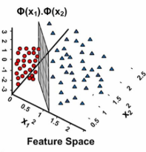
SVM
Logistic regression
SVMs are based on the idea of finding a hyperplane that best divides a dataset into two classes, as shown in the image below.
The distance between the hyperplane and the nearest data point from either set is known as the margin. The goal is to choose a hyperplane with the greatest possible margin between the hyperplane and any point within the training set, giving a greater chance of new data being classified correctly.
Logistic regression is the appropriate regression analysis to
conduct when the dependent variable is dichotomous (binary).
Like all regression analyses, the logistic regression is a predictive analysis.
Logistic regression is used to describe data and to explain the relationship
between one dependent binary variable and one or more nominal, ordinal,
interval or ratio-level independent variables.

Slide 5
List of hyper parameter per algorithm
Logistic Regression K Neighbors Classifier SVM –linear Random Forest Classifier - Gradient Boosting Classifier

